Slide 1
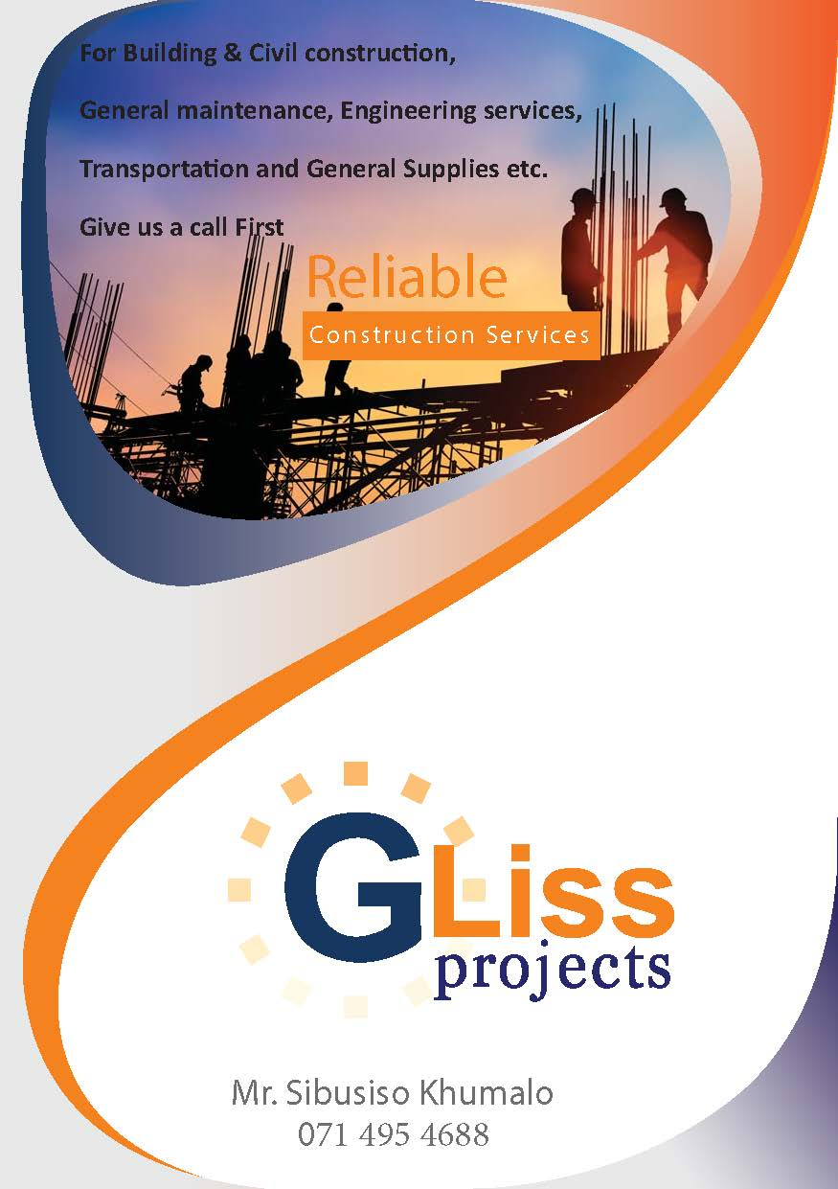
Gliss Projects Pty Ltd: Comprehensive Overview of Mining and Construction Services

Slide 2






Business Overview
1
Emerging Mining Services Company
2
BEE Contribution Status
As a Level 1 BEE contributor, Gliss Projects is dedicated to fostering economic growth and community development within the regions we operate.
Gliss Projects Pty Ltd is an innovative mining services firm based in Witbank, focused on delivering exceptional service in mining and construction sectors.
3
Diverse Service Offerings
4
Strategic Partnerships
The company specializes in mining services such as plant hire, bulk earthworks, and underground support services, showcasing a wide range of capabilities.
Through strategic alliances, Gliss Projects has enhanced its service offerings, expanding into areas like underground and rehabilitation and contract mining .

Slide 3
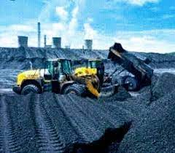
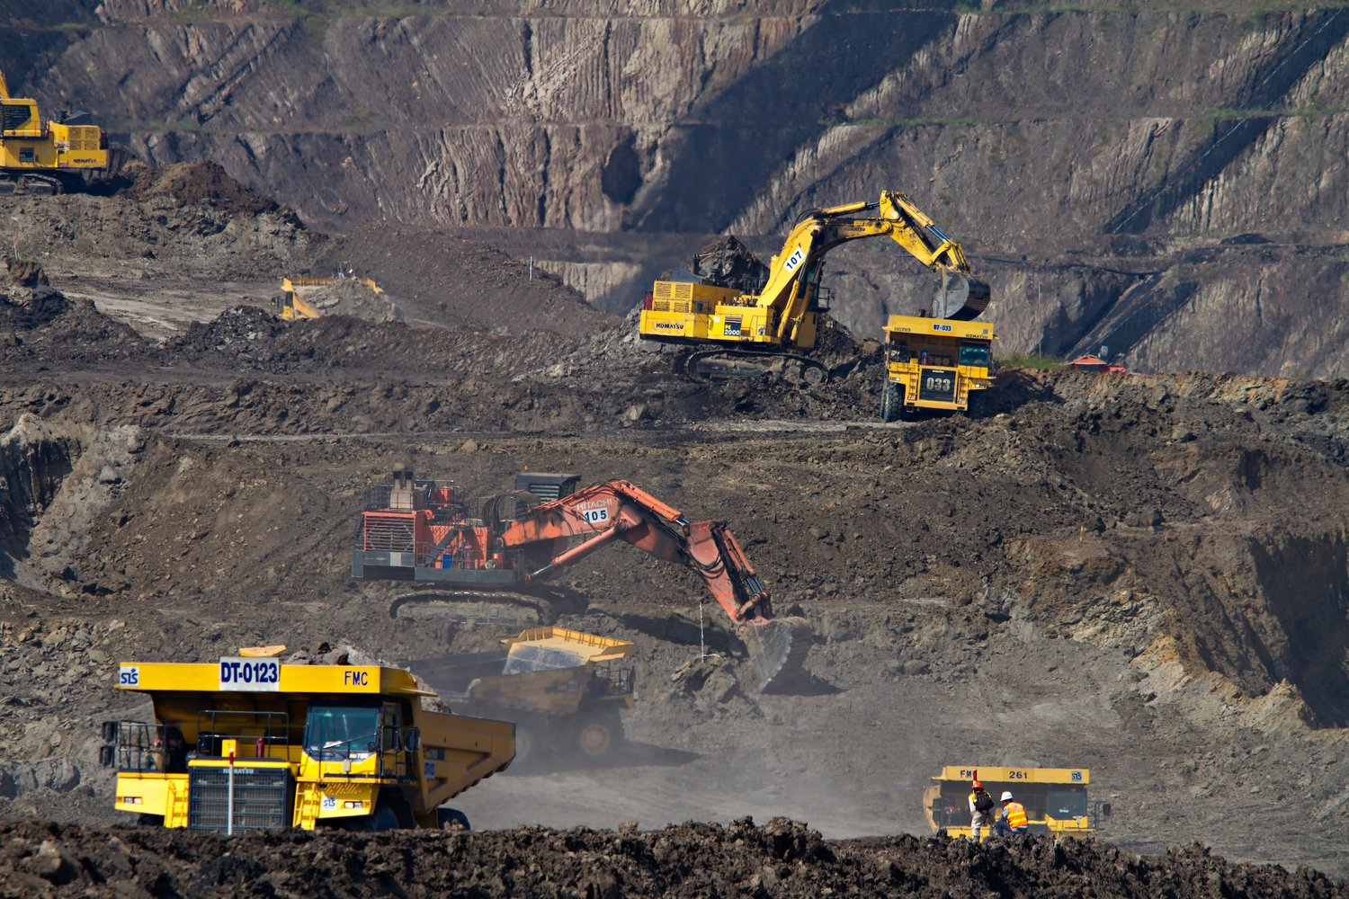
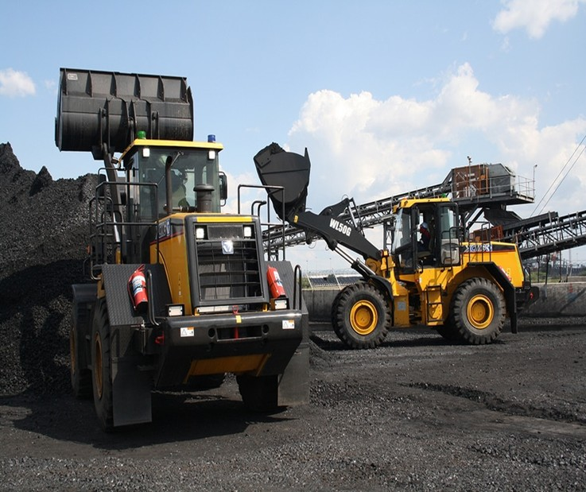
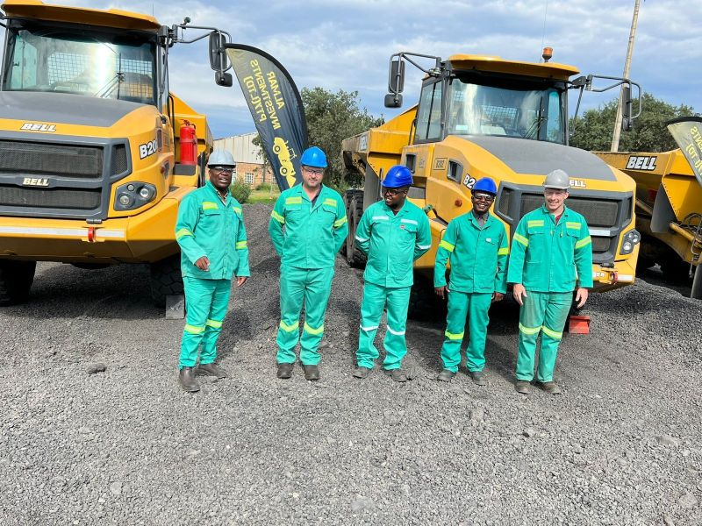
Three-tier model focuses on contract mining, underground rehabilitation, and material handling.
Integrated Mining Services
Gliss Projects offers a comprehensive suite of mining services including contract mining and material handling for optimal operations.
Sustainable Rehabilitation Practices
Emphasis on rehabilitation services ensures environmental responsibility while enhancing resource recovery in mining operations.
Efficient Materials Handling Solutions
Expertise in materials handling maximizes productivity and minimizes waste during mining and construction projects.
Strategic Partnerships for Growth
Collaborative efforts through strategic partnerships enhance service offerings and expand operational capabilities in mining.

Slide 4
Gliss Projects Pty Ltd
Accreditations
Social Responsibility and BEE Contributions
Construction Industry Development Board
Private Security Industry Regulatory Authority (PSiRA)
ISO 9001:2015
QUALITY MANAGEMENT
SYSTEMS (In-progress)
As a level 1 BEE contributor, Gliss Projects is committed to uplifting local communities and promoting social equity.
CIDB LEVEL 5 CE PE
CIDB LEVEL 4 GB PE
PSIRA GRADED

Slide 5

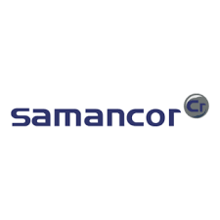
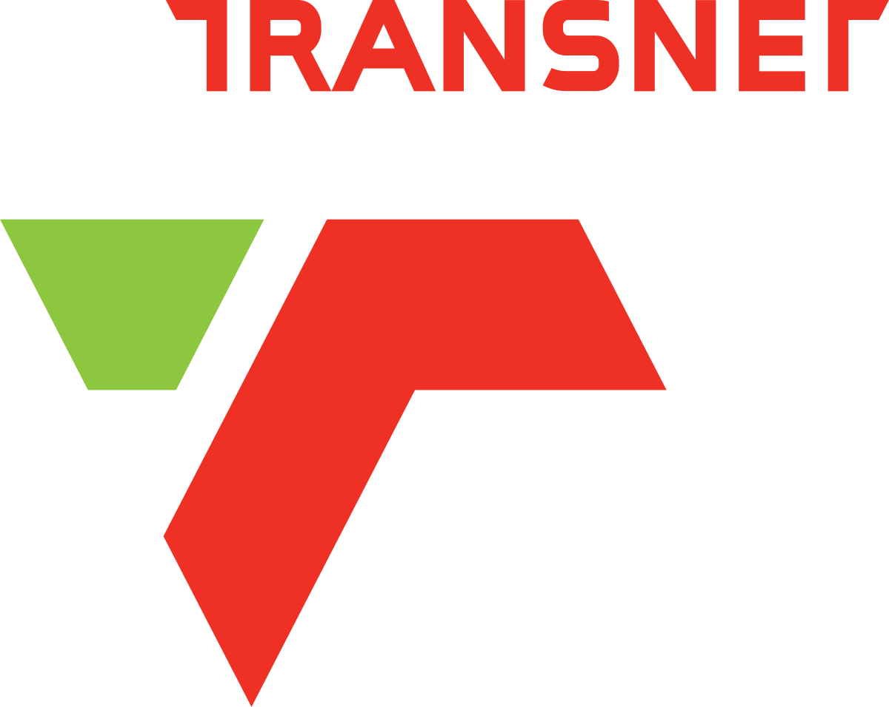
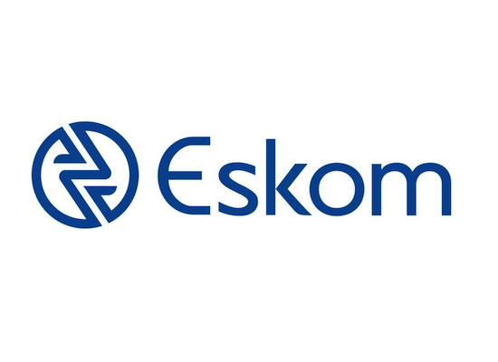
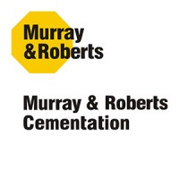

3 Current Projects and Key Collaborations
Sandton Plant Hire Collaboration
Samancor Chrome Recovery
Execution of chrome recovery and cold slag processing operations that enhance resource recovery efficiency.
Date: 2022-Current
Value: R 66 823,200.00
Partnership with Sandton Plant Hire for optimized Underground and Opencast services to improve project outputs , Has Availed Equipment to the value of R370 000 000 to Gliss Projects Pty Ltd
Rail Sliding and Road Leveling
Eskom Coal Reclaimer Project
Engagement in coal reclaimer operations for Eskom SOC that ensures efficient material handling.
Date: 2020-2023
Value: R 34 423,200.00
Wagon Loading of Coal and road leveling for efficient and smooth operations
Date: 2020-2023
Value: R 24 951,600.00
M&R Cementation Khuthala Mine Roof Support Project
Emalahleni Local Municipality
Roof Support Services with a Manitou Cherry picker and Supply of Nets and Roof Bolt Underground Anchor Rod Pneumatic machines .
Date: 2019-2020
Value: R 16 794,664.00
Water And Sanitation Project for the community ,Services is to supply Water Trucks and distribution of water
Date:2024-Current
Value: R18 092,400.00

Slide 6
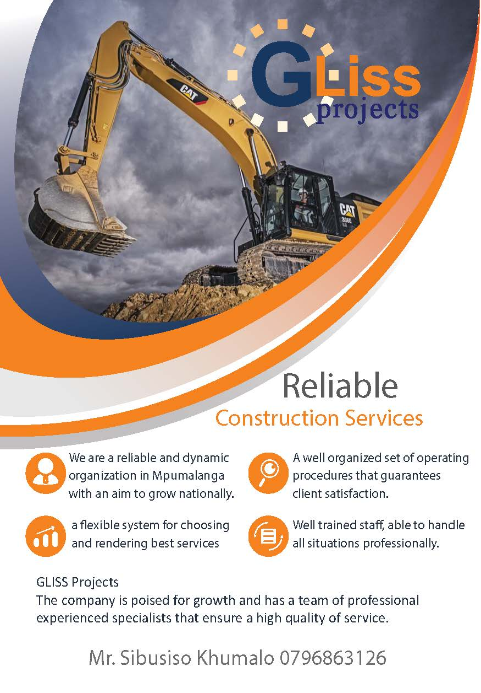
Thank You
Gliss Projects Pty Ltd (SA)

